Slide 1
Introduction to Programming
Lesson 1: First Steps in Coding

Slide 2
Table of contents
What means programming?
My first program with C# and Visual Studio
How to create console application
How to create windows forms application
How to create web application

Slide 3
What is programming
“Programming” is the process of giving commands to the computer in order to “tell” him what to do.
Commands are given one by one in a specific order
That’s how we create “computer program”
The computer program is a sequence of commands
To write program we have to use a programming language
For example C#, Java, JavaScript, Python, PHP, C, C++, …
We have to use development environment (example: Visual Studio)

Slide 4
Sample computer programs
Program which play a sound (for 0.5 seconds)
Program which plays a sequence of sounds:
Program to convert currencies BGN to EUR:
Console.Beep(432, 500);
for (int i = 200; i <= 4000; i += 200)
Console.Beep(i, 100);
var leva = int.Parse(Console.ReadLine());
var euro = leva / 1.95583;
Console.WriteLine(euro);

Slide 5
Computer programs
Program = sequence of commands
Can contain commands, calculations, validation, loops, etc.
Programs are written as a text (files)
Text of the program is called source code
Source code can be compiled to executable file

Slide 6
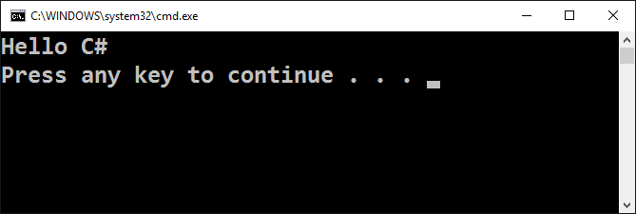
My first console application

Slide 7
Working Environment
In order to be able to develop you will need working environment
Integrated Development Environment (IDE)
For C# → Visual Studio; for Java → Eclipse; for PHP → PHP Storm
Install Visual Studio Community 2017
https://visualstudio.microsoft.com/vs/community/
Could be any older version of Visual Studio

Slide 8
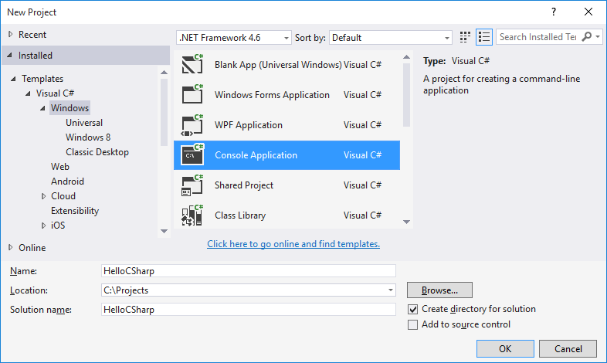
Creating console application
Start Visual Studio
Create New Project
File
New
Project

Slide 9
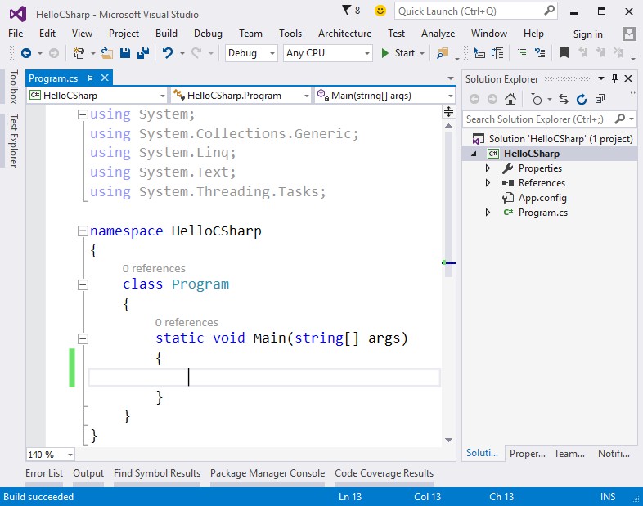
Writing source code
You have to write your code inside the section Main(string[] args)

Slide 10
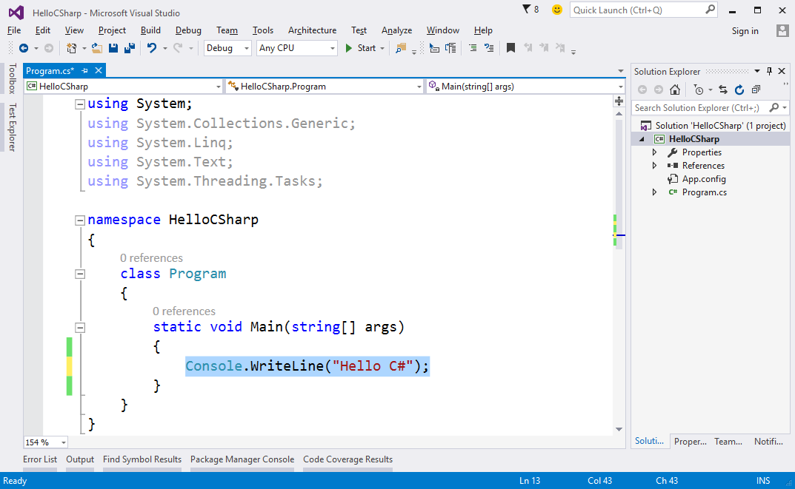
Writing source code (2)
Please write the following code Console.WriteLine("Hello C#");

Slide 11
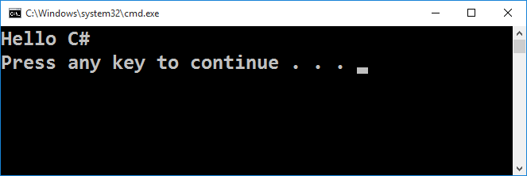
Running our program
To start the program – press F5 or Ctrl+F5
If there are no errors the execution will be successful
The result of the execution will be displayed in the console

Slide 12






Some typical errors in C#
Writing code outside the Main() method
Mixing uppercase and lowercase
Missing “;” at the end of the row
Missing “ or } or )

Slide 13
Console app lab
Work in class …

Slide 14
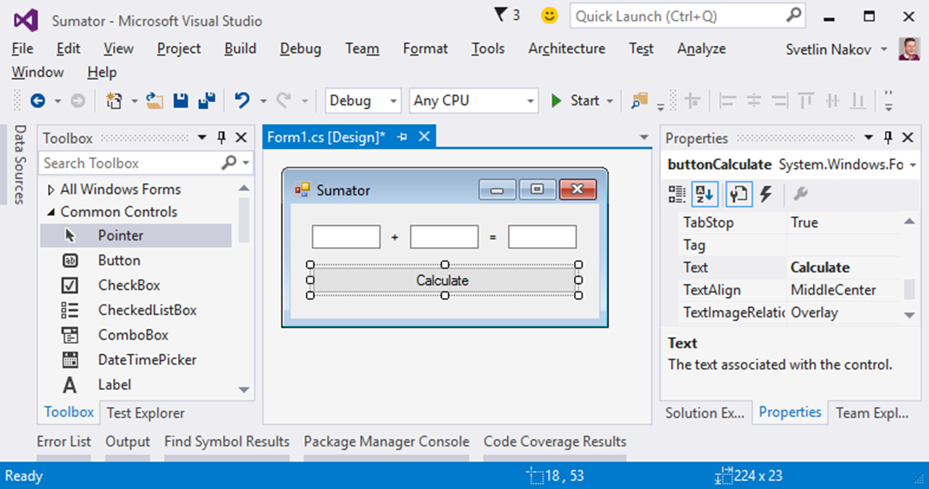
Development of Windows forms application

Slide 15
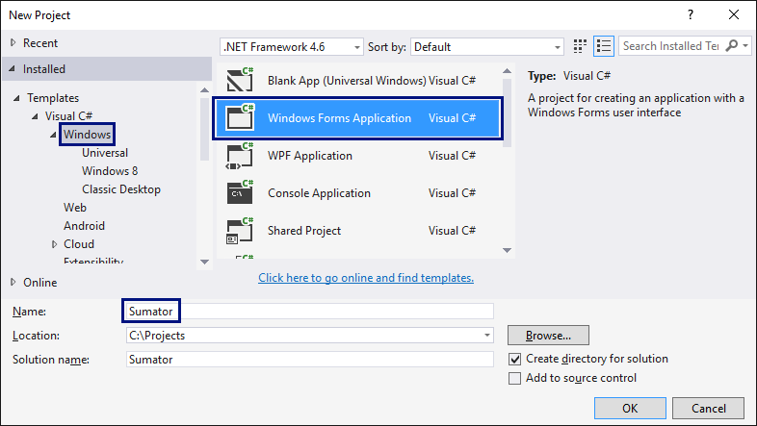
Create new project

Slide 16
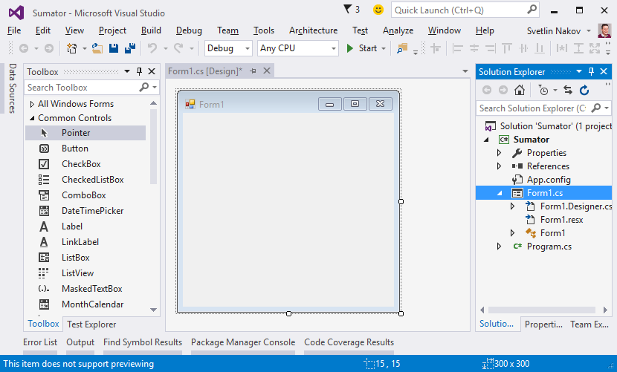
User Interface (UI) editor

Slide 17
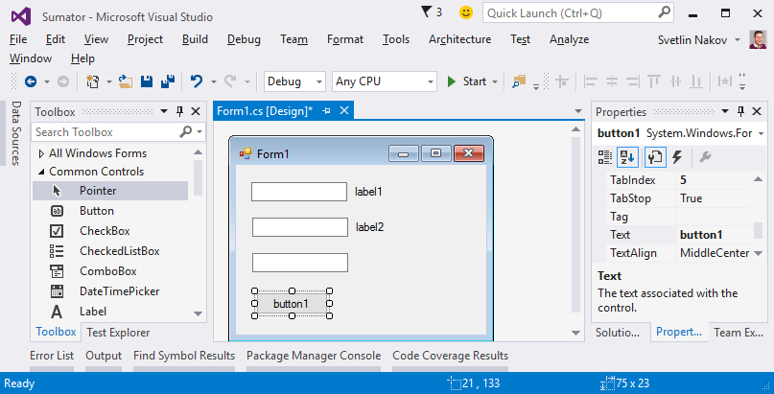
Adding user controls inside the form

Slide 18
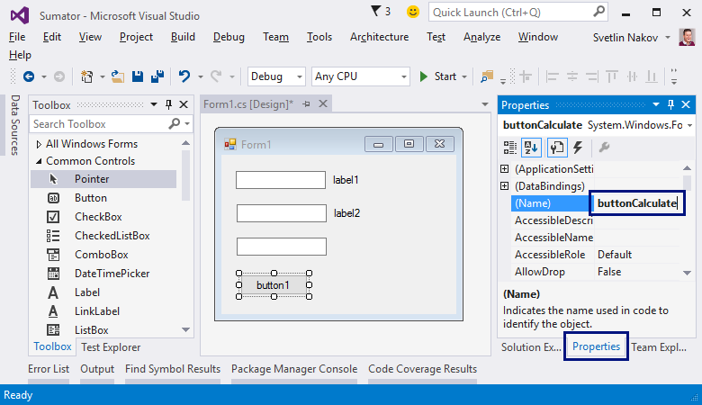
Naming controls
Text boxes:
textBox1,
textBox2,
textBoxSum
Button:
buttonCalculate
Form:
FormCalculate

Slide 19
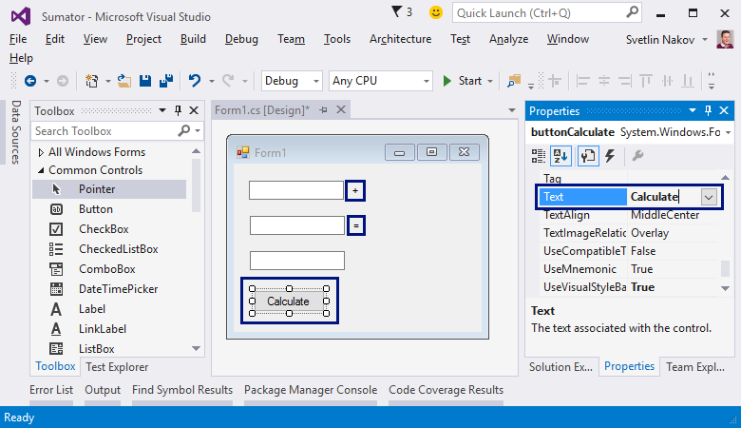
Adding titles
buttonCalculate
"Calculate"
label1
"+"
label2
"="
Form1
"Sumator"

Slide 20

Aligning controls

Slide 21
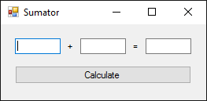
Testing the application
Ctrl+F5
App is running, but nothing is working … ☺

Slide 22
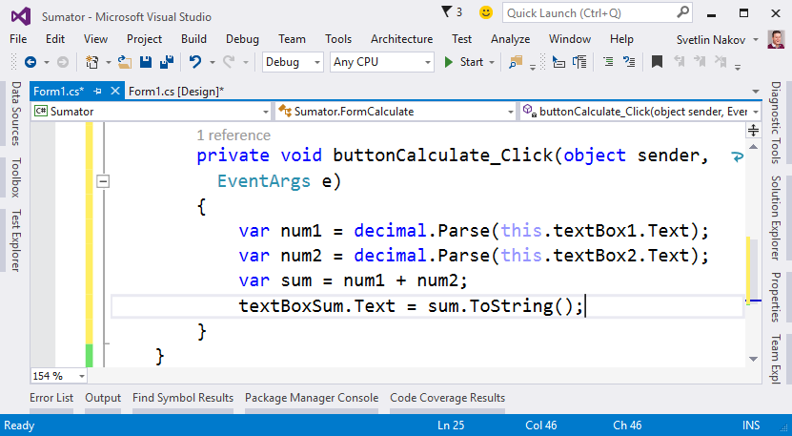
Writing code for the Calculate button

Slide 23
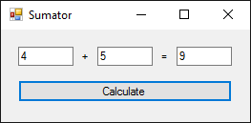
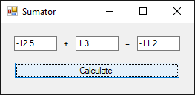
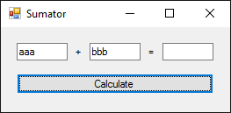
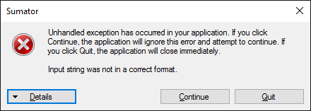
Testing the application (Ctrl+F5)

Slide 24
Modify code to convert text to number
private void buttonCalculate_Click(object sender, EventArgs e)
{
try
{
var num1 = decimal.Parse(this.textBox1.Text);
var num2 = decimal.Parse(this.textBox2.Text);
var sum = num1 + num2;
textBoxSum.Text = sum.ToString();
}
catch (Exception)
{
textBoxSum.Text = "error";
}
}

Slide 25
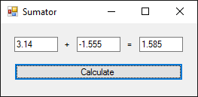
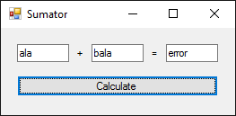
Testing again …
All is working good
When we enter numbers – we will have result
When we enter texts – we will have error text

Slide 26
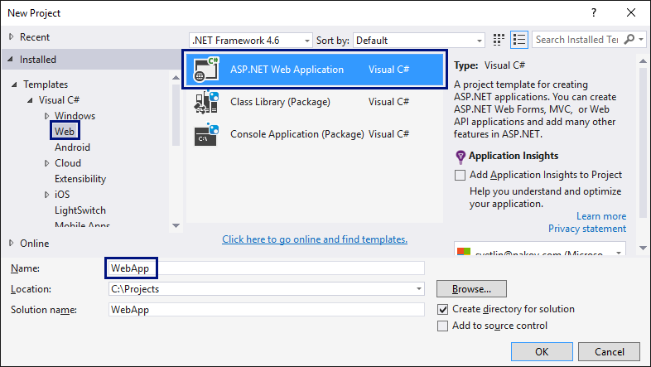
Creating Web Application

Slide 27
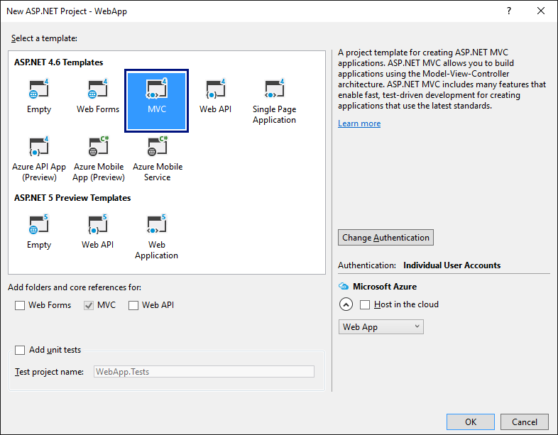
Creating Web Application (2)

Slide 28
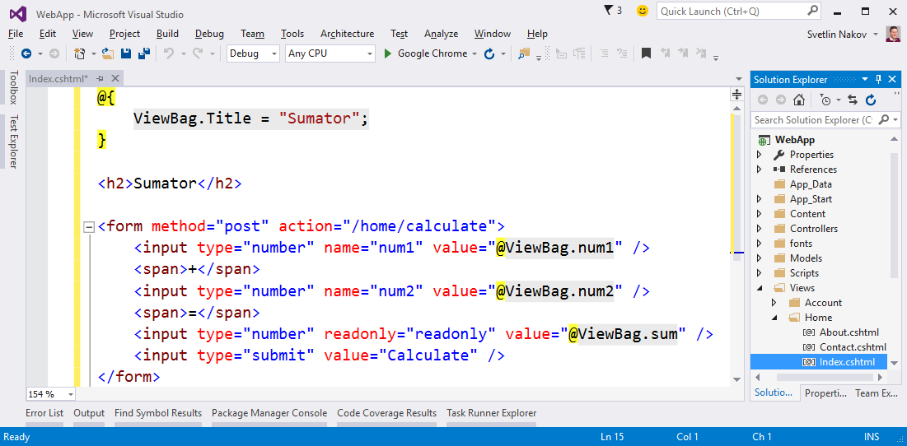
Creating View

Slide 29
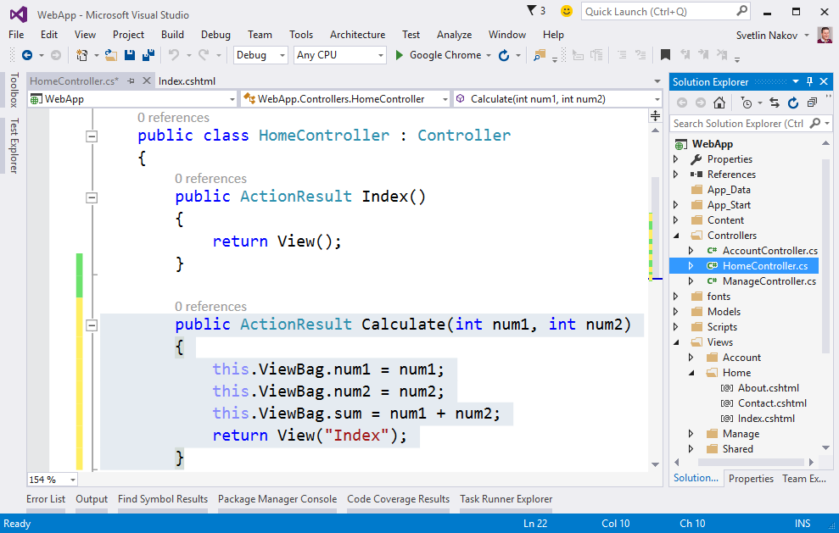
Creating Action – HomeController

Slide 30
Questions?

